Slide 1

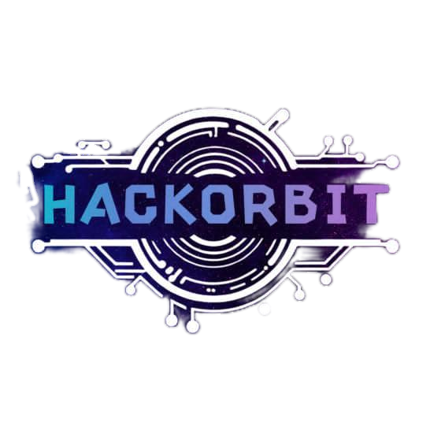


HackOrbit 2025
Gurlaxy

Slide 2

THEME & PROBLEM STATEMENT
Existing rehabilitation gloves are limited to therapy exercises and do not support daily tasks.
Full-hand paralyzed individuals rely heavily on caregivers.
Current products:
-Support only fingers/wrist.
-Require manual/mirroring assistance.
-Are expensive, heavy, and task-limited.

Slide 3
PROPOSED SOLUTION
Title: Smart Full-Arm Exoskeleton Glove with Voice and Blink Controlled Object Handling
Solution: Lightweight glove-exoskeleton enabling independent basic tasks.
Addresses Problem: Empowers daily actions like brushing and eating.
Innovation:
Full-hand actuation (shoulder to fingers).
YOLOv8 object detection.
Minimal control via blink & voice.

Slide 4
Voice command (eg: brushing) via microphone & voice recognition module
Blink detection via IR sensor
Double blink to continue
One long blink to cancel
Object (brush) detection with YOLOv8
on Raspberry pi
Camera(capture real-time visual)
Arduino
Servo motors
Linear Actuators
Exoskeleton executes Motion(Object
Grasping/Handing task completed)

Slide 5
FLOWCHART / DIAGRAM
Inputs: Microphone (voice), IR sensor (blink), Camera (vision).
Processing Units: Raspberry Pi 4 (AI/vision), Arduino (motion control).
Actuation:
12 Servo Motors: 2 joints/finger(2×5), 2 for wrist.
6 Linear Actuators(3×2): Shoulder and elbow (X, Y,Z direction
movements).
Algorithms & Programming: YOLOv8 (Python), Control Logic (C++).
Structure: 3D-printed lightweight exoskeleton.
Control: PWM for adaptive grip strength

Slide 6
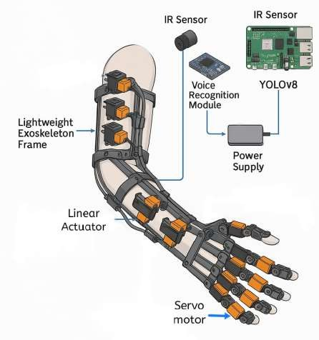
FEATURES AND NOVELTY
Technical:
Modular, expandable design
Voice & blink control (low AI use)
Low-power actuators for basic daily tasks
Economic:
Cost < ₹50,000 vs ₹3,00,000+ market price
DIY-friendly, easy maintenance
Social:
Boosts user independence and dignity
Inclusive for rural and disabled users
Environmental:
Low energy use,Recyclable and sustainable materials

Slide 7
DRAWBACK AND SHOWSTOPPERS
Limited control precision – Blink and voice commands may not suit all actions or users.
Basic functionality only – Currently supports only essential tasks (e.g., brushing, eating).
Battery limitations – May need frequent charging with extended use.
No full joint freedom – Fine motor control (like writing) may not be achievable yet.

Slide 8
Gurlaxy
Pavithra S
pavithraselvaraj205@gmail.com
Nandhini devi K
nandhinidevi0677@gmail.com
Eswari E
eswarimuthu2006@gmail.com

Slide 9
Thank you

